Slide 1
Web Testing Tutorial & E-Commerce Demo
Course -SER598 Web Based Applications
Team Members :
Yashwanth Sundhar Sundaramoorthy
Tejeshwar Moongilmada Krishnaswamy
Sai Krishnan

Slide 2
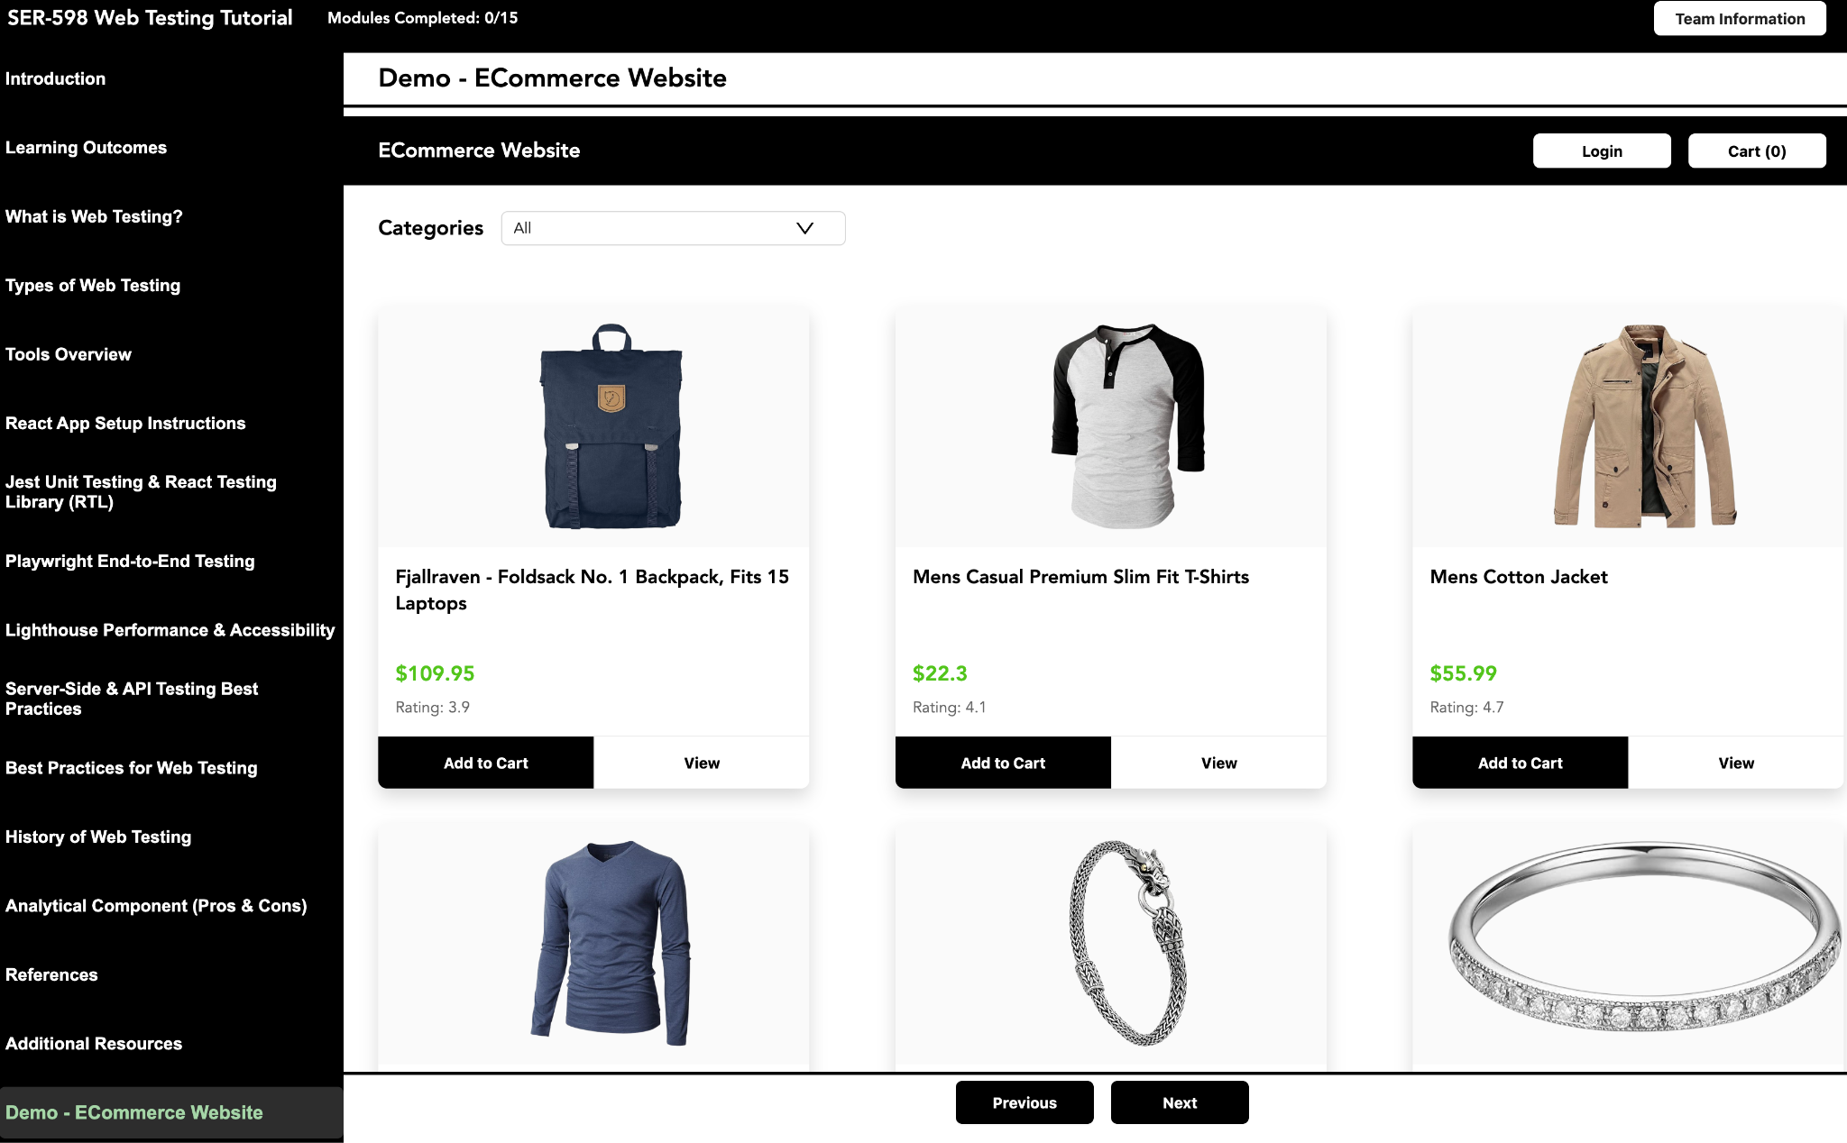
Why Web Testing Matters ?
Web applications today are:
Highly interactive
API-driven
Used across multiple devices
Dependent on performance & security
Therefore testing ensures:
Functional correctness
Stability under different conditions
Security of user data
Good user experience
Accessibility for all users
A web application is never complete until it is tested thoroughly.

Slide 3
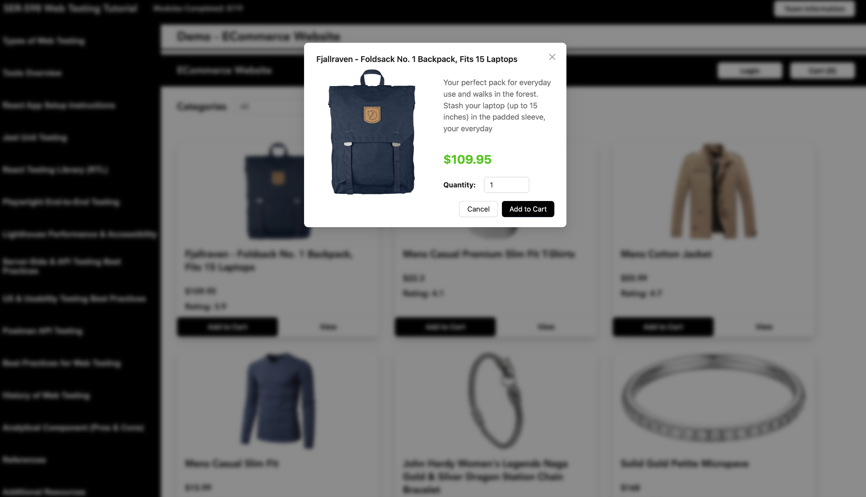
What is Web Testing ?
Web testing is the process of evaluating a web application to make sure it behaves correctly,
performs efficiently, is secure, and provides a good user experience. Modern applications have many layers frontend UI, backend APIs, databases, authentication, performance so testing ensures all of these work together smoothly.
Web testing verifies:
Features behave as expected
Application remains stable under different inputs
Performance stays within acceptable limits
Accessibility compliance
Data accuracy & API reliability

Slide 4
Types of Web Testing
1. Unit Testing
Tests one small function or component
Fastest type of test
Helps prevent small bugs from spreading
2. Integration Testing
Tests how two or more parts work together like multiple components
Example: Form + Validation + API
3. End-to-End Testing
Mimics a real user using the browser
Example: User logs in → adds product → checks out
4. API Testing
Tests backend behavior
Ensures server returns correct data and handles errors
5. Performance Testing
Tests page speed and responsiveness

Slide 5
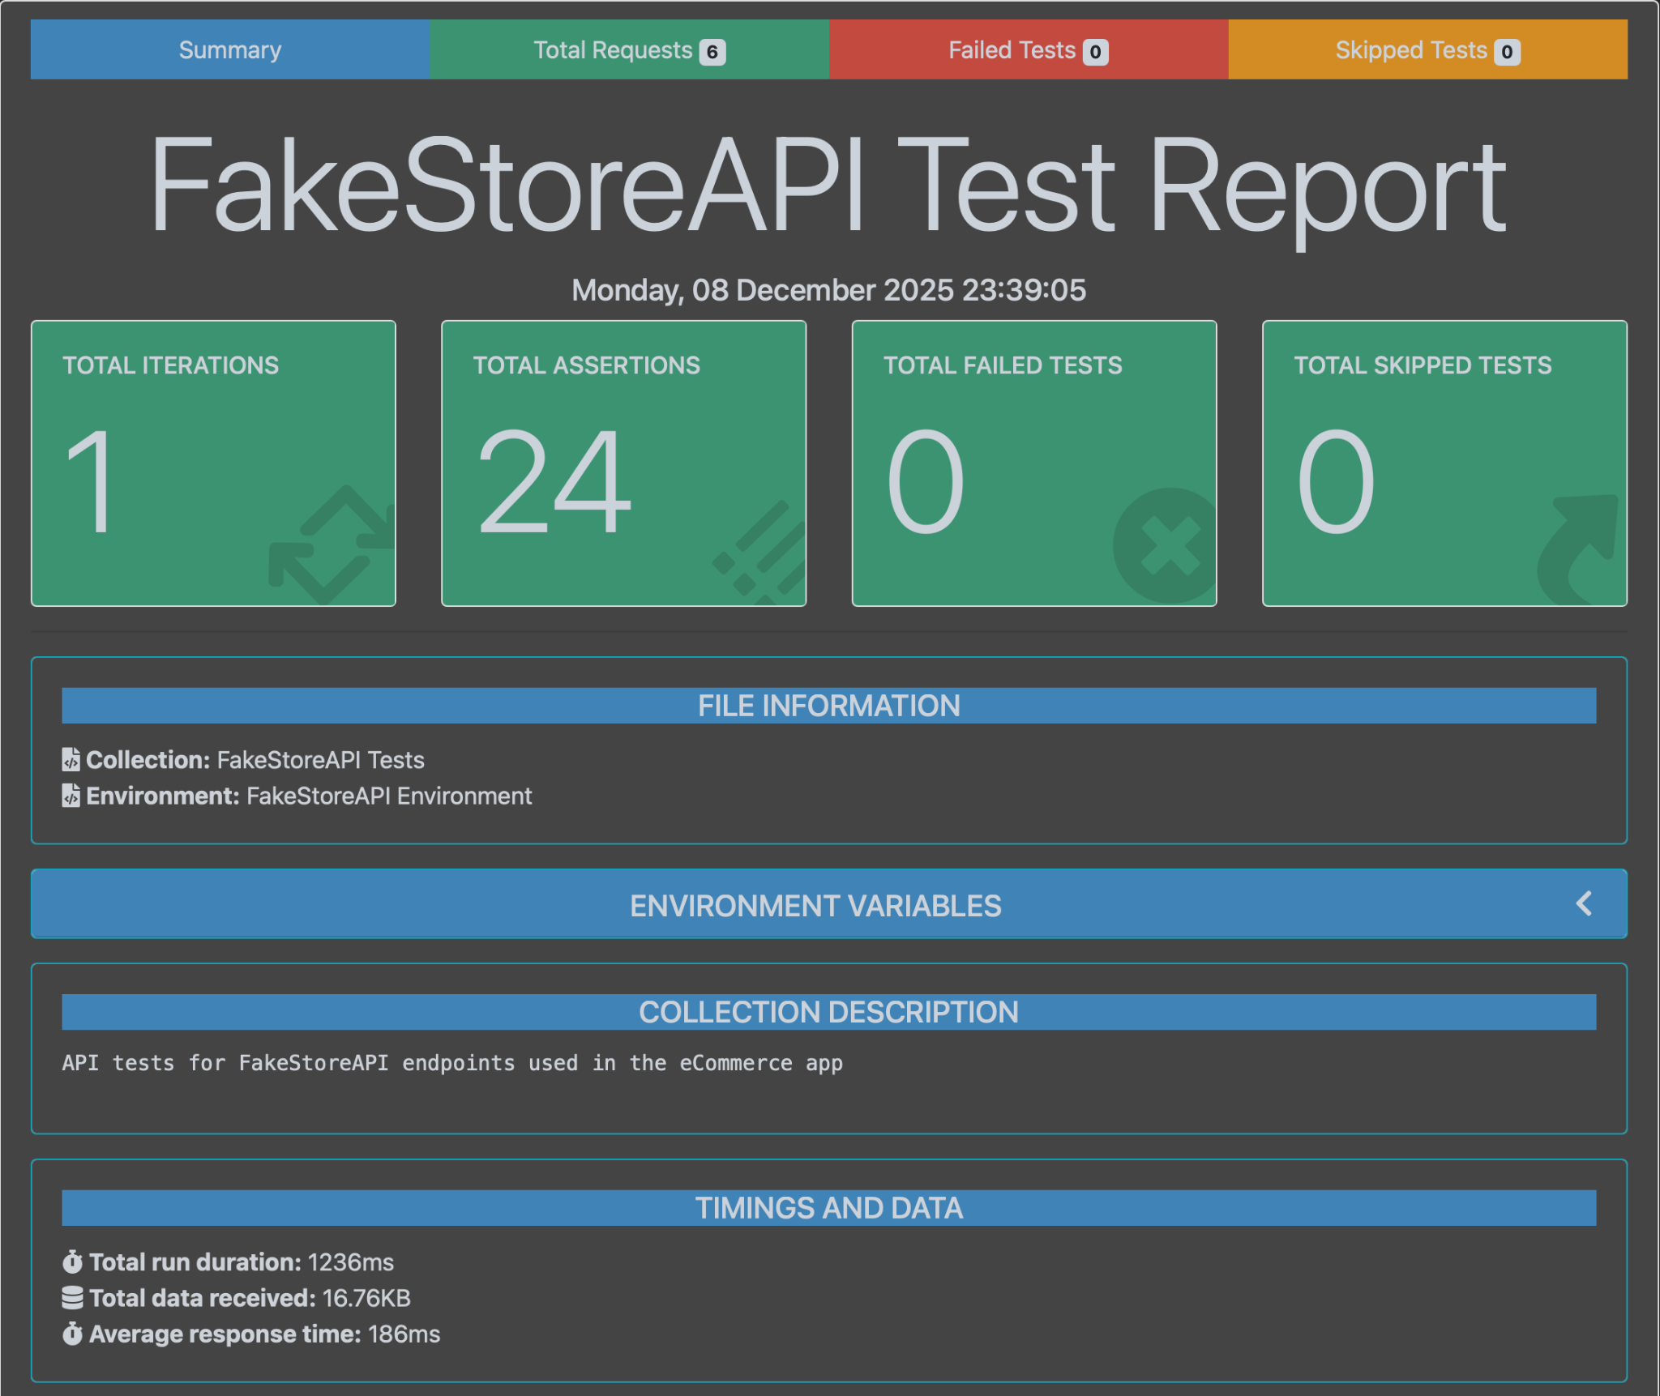
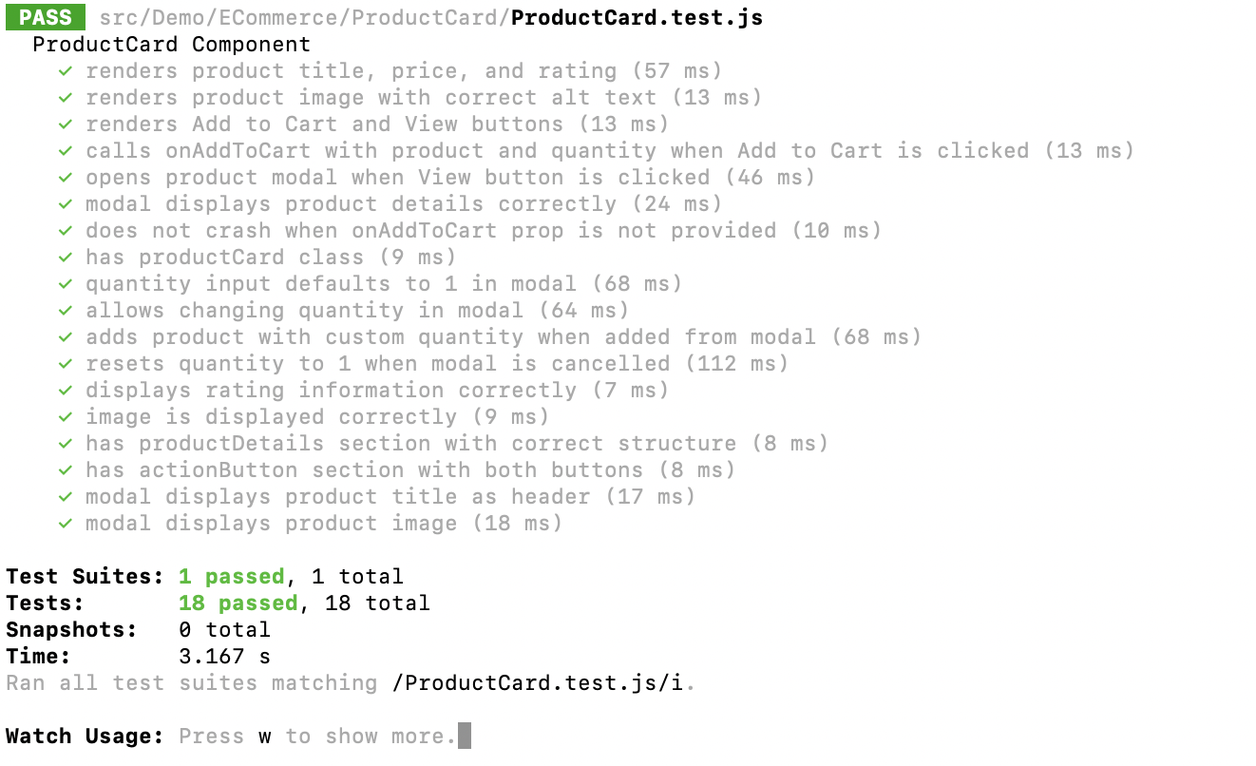
Tools used for Web Testing
Tools we will learn:
Jest for unit testing
React Testing Library for component-level integration testing
Playwright for end-to-end browser automation
Lighthouse for performance and accessibility audits
Postman + Newman for API testing and server-side validations

Slide 6
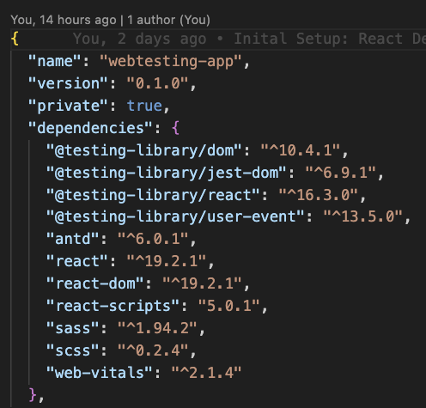
React Application Setup
For the tutorial, We have created a React application using Create React App.
React works internally with concepts like components, state, props, and the Virtual DOM were React updates only what has changed instead of re-rendering the whole page.
The project structure, especially the package.json file, which manages dependencies and build scripts like npm start, npm test, and npm run build.

Slide 7
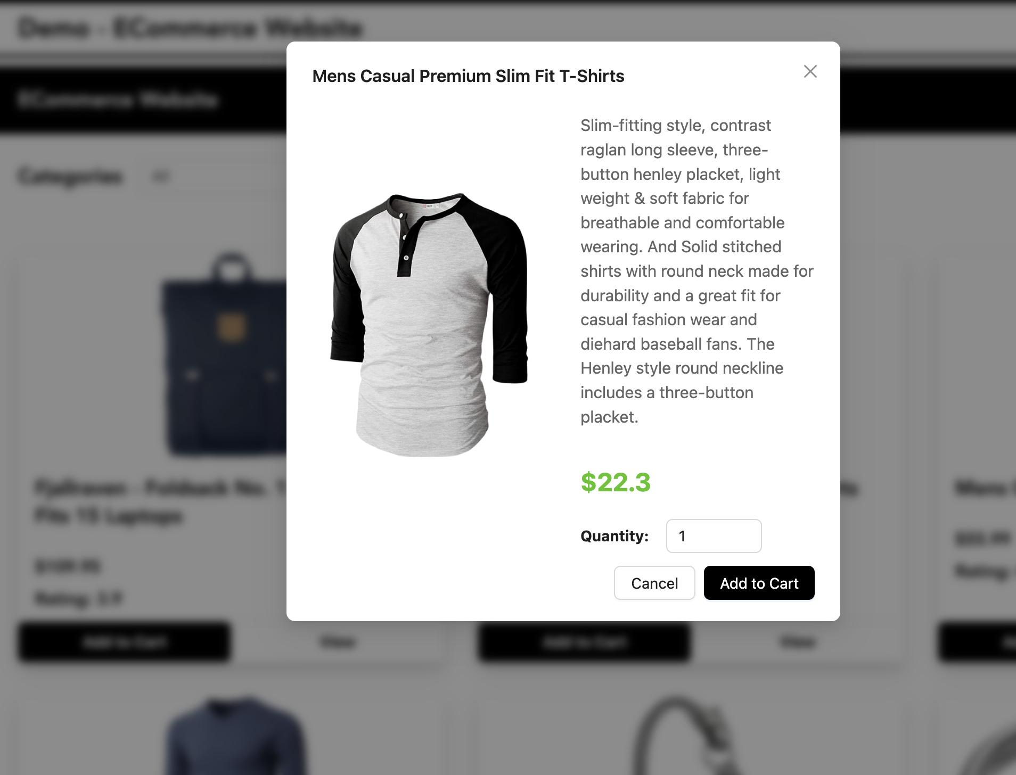
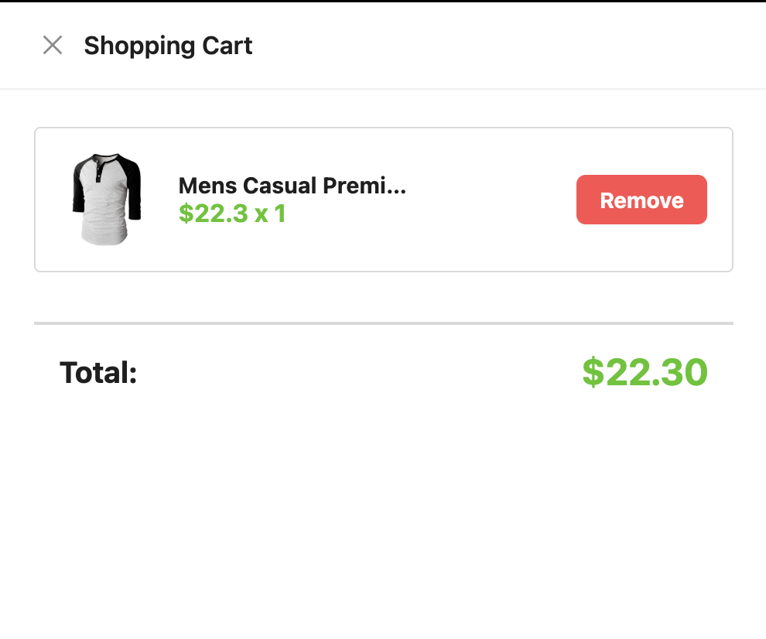
E-COMMERCE DEMO APPLICATION
Features implemented:
Product listing from FakeStoreAPI
Category-based filtering
Product details modal
Add-to-cart functionality
Cart drawer with totals
Login modal
Why this application?
Covers real user scenarios
UI + API integration
Multiple states, modals, interactions
Perfect for demonstrating all testing types

Slide 8
Testing - Client Side (Jest + RTL)
Jest
Jest is a JavaScript testing framework used for unit and integration testing.
It comes bundled with React projects (Create React App).
Provides tools like:
  test() — define a test
  expect() — make assertions
  jest.fn() — create mocks
  Automatic test running and reporting
Jest is fast, reliable, and ideal for testing logic and component behavior.
React Testing Library (RTL)
RTL is a library designed to test React components the way a real user interacts with them.
Focuses on, Finding elements by text, role, label and Simulating user behavior (clicking, typing)
RTL does NOT test implementation details it tests visible UI behavior.
Works together with Jest to produce complete UI-level tests.

Slide 9
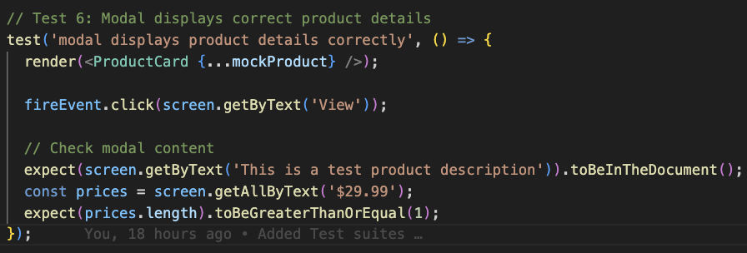
Pros of using Jest + RTL Together
Jest handles the test logic, assertions, mocks, and test runner. RTL handles DOM rendering and user simulation.
Combined, they help us test:
Component output
User interactions
Conditional rendering
State changes
API-driven UI updates

Slide 10
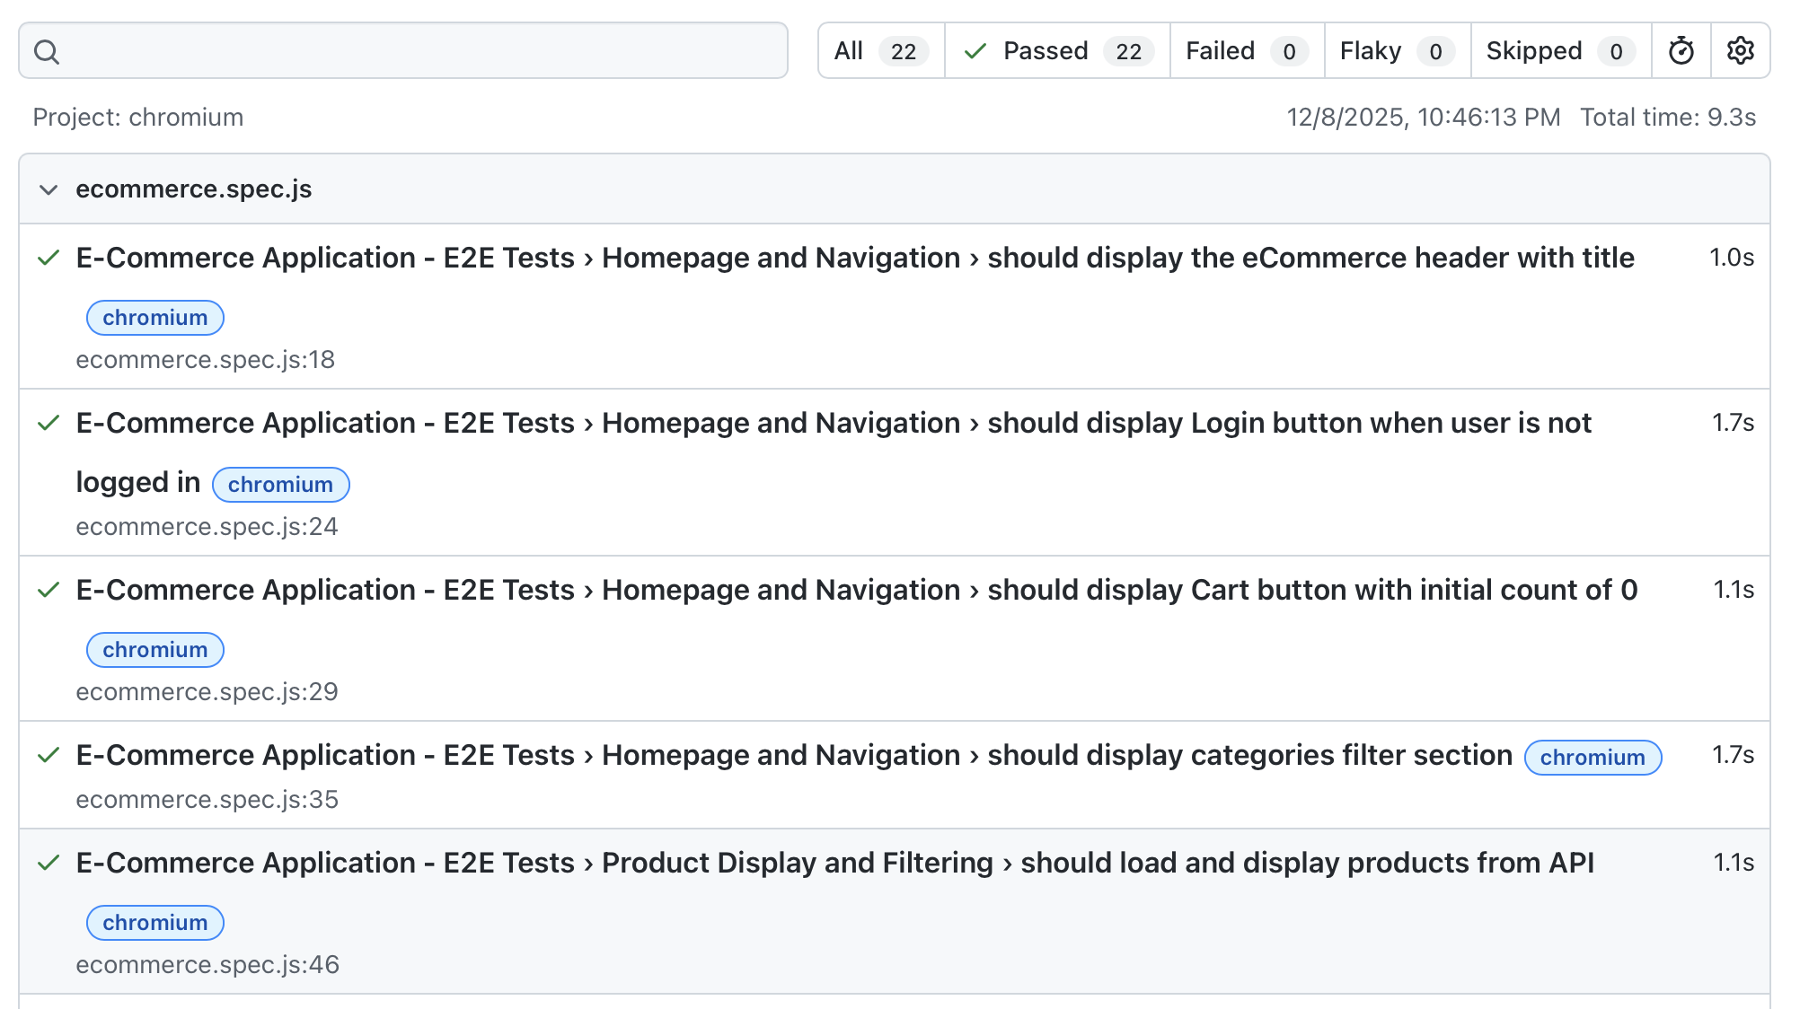
End-to-End Testing (Playwright)
Playwright is a modern end-to-end (E2E) testing framework created by Microsoft.
It make use of real browsers : Chromium, Firefox and WebKit
It can simulate everything a real user does like opening pages, filling out a form.
It supports auto-waiting, meaning tests wait for UI changes.
Unit + integration tests (Jest + RTL) only test components in isolation.
But they do not test the full application flow.
Playwright is needed to verify:
Does the whole app work correctly from the user's perspective?
Do frontend + backend + UI interactions all work together?

Slide 11
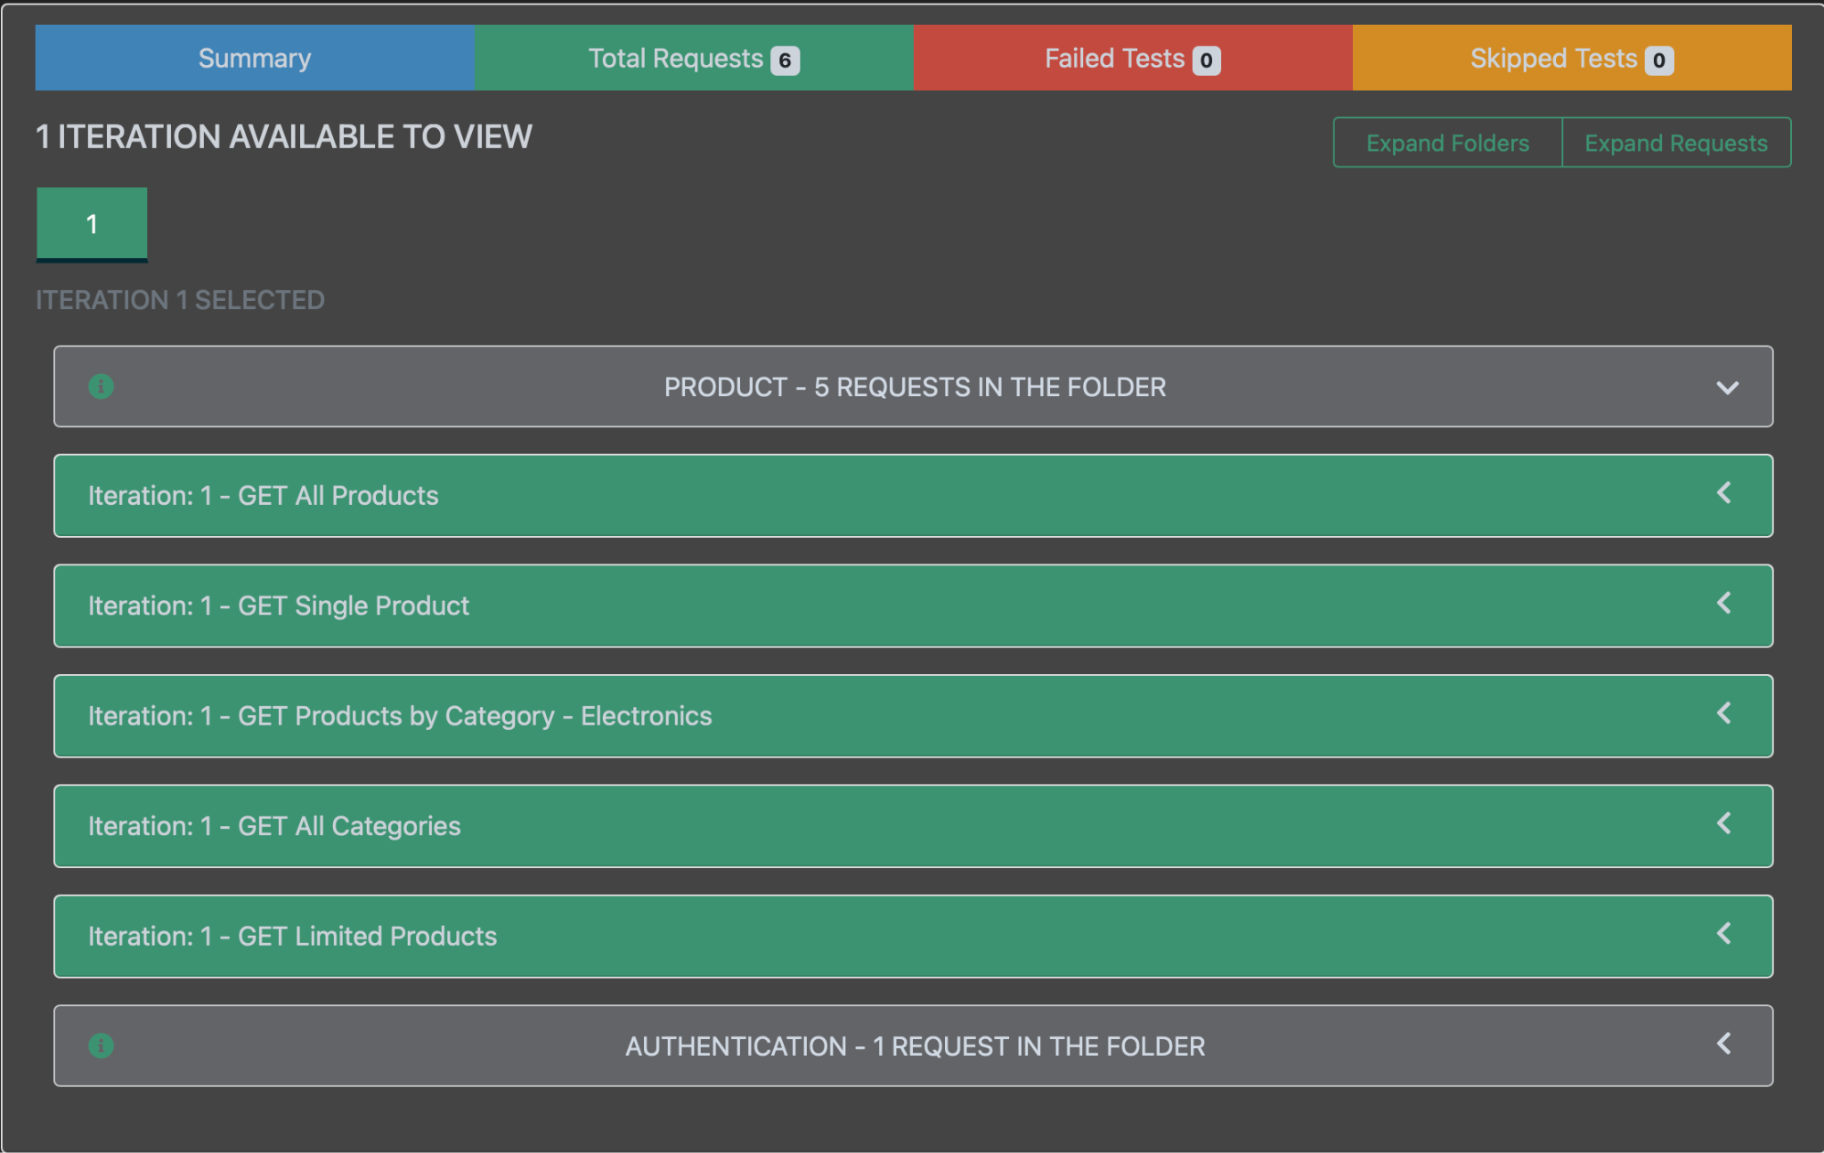
Testing - Server Side (Postman + Newman)
API Testing checks whether backend endpoints return the correct data, with the correct status codes, in valid formats, and within acceptable response times. Unlike UI tests, API tests interact directly with the server, making them faster and more reliable. Ensures frontend and backend integrate smoothly.
Newman is Postman’s command-line runner.It allows: Running Postman tests automatically from terminal, Adding API tests to CI/CD pipelines, Generating HTML reports
Our Test covers FakeStore API Endpoints for :
Fetch All Products, Product by ID and User Login Auth

Slide 12
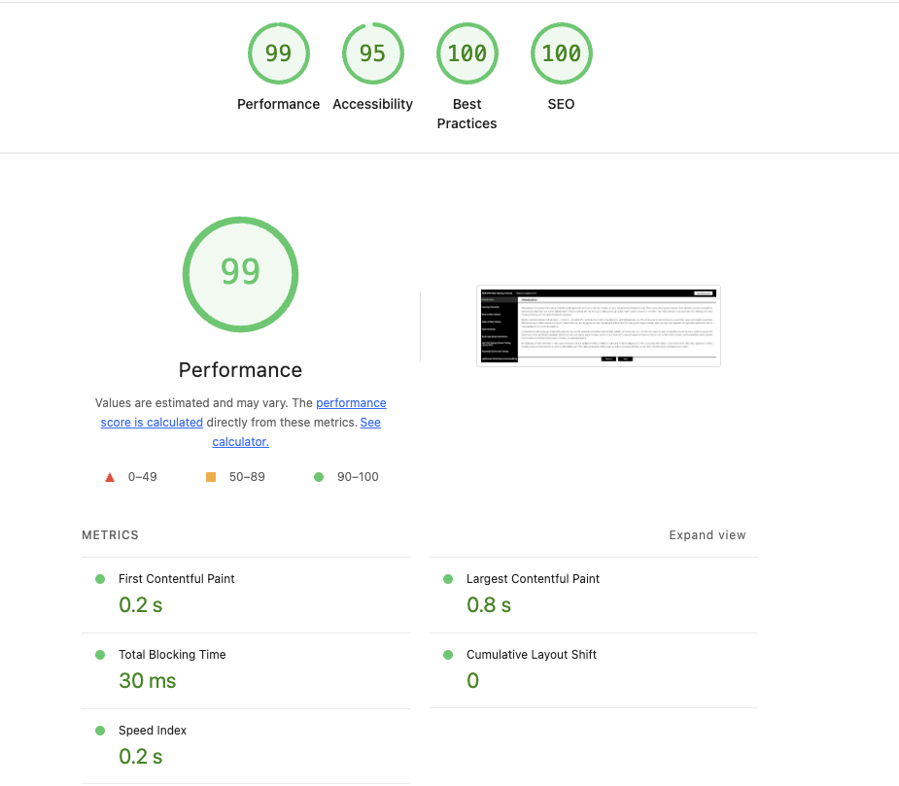
Application - Performance & Accessibility
Lighthouse is an automated auditing tool built into Chrome that evaluates the quality of a web application across:
Performance
Accessibility
SEO
Best Practices
It helps developers understand how real users experience the site and provides actionable suggestions for improvement.
Important metrics:
LCP (Largest Contentful Paint)
Measures how long it takes for the largest visible element (image/header) to load.
TBT (Total Blocking Time)
Measures how long the main thread is blocked by heavy JS, delaying user interaction.

Slide 13
Best Practices for Web Testing
Follow the Testing Pyramid
Use many small Unit Tests, fewer Integration Tests, and only a few E2E Tests.
Keeps the test suite fast, reliable, and cost-effective.
Unit tests → catch logic bugs early
Integration tests → verify modules work together
E2E tests → validate complete user flows
Write Tests Early ("Shift-Left Testing")
Start testing while building features, not after.
Helps catch bugs before they reach production.
Keep Tests Independent & Isolated
Tests should not depend on each other.
Use beforeEach / afterEach to reset data.
Avoid shared mutable state → prevents unpredictable failures.
Mock External Dependencies
Replace network calls, databases, or services using Jest mocks.
Allows tests to run offline and instantly.
Prevents failures caused by API downtime.

Slide 14
Best Practices for Web Testing
Run Tests in CI/CD
Automate testing on every push or pull request.
Prevents broken code from being merged.
Use GitHub Actions, Jenkins, GitLab CI, etc.
Track Test Coverage Wisely
Use coverage tools to identify untested areas.
Don’t chase 100% coverage—focus on critical logic & user flows.
Coverage is a guide, not a success metric.

